Slide 1
DATA SCIENCE PROJECT
VIDEO GAMES

Slide 2

OUR TEAM
TOM SEGAL
MATAN ALTER
GITHUB

Slide 3
COOL VIDEO GAMES FACTS
The first color portable video game system was the Atari Lynx, introduced in 1989 and priced at $149.
Introduced in 1993, the 3DO was the first video game system to be based entirely on CD technology.
The Sega Dreamcast was the first console to implement online play over a phone line, calling the system Sega Net.
The Microsoft Xbox was the first video game system to provide full support for HDTV.
Popular Science recognized the Sega Dreamcast as one of the most important and innovative products of 1999.
The Magnavox Odyssey, released in 1972, contained 40 transistors and no microprocessor. The Pentium 4 microprocessor contains 42 million transistors on the chip itself!
The PlayStation 2 was the first system to have graphics capability better than that of the leading-edge personal computer at the time of its release.

Slide 4
256,970,000,000$
GAMING INDUSTRY WORTH IN 2021

Slide 5
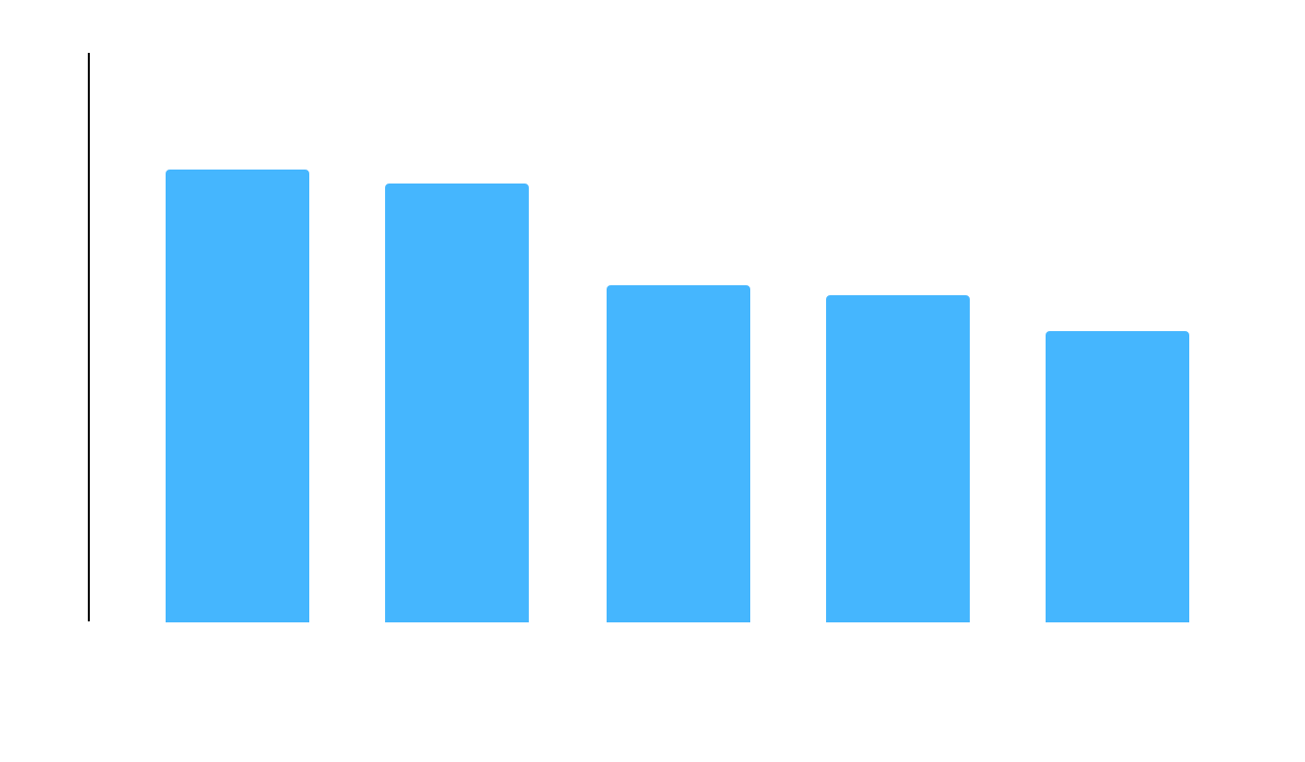
TOP 5 BEST-SELLING CONSOLES

Slide 6
RESEARCH QUESTION
Is is possible to predict if a game will be successful or not according to its features
And what are the best features to use

Slide 7
MAIN STEPS
01
02
03
04
DATA
ACQUISITION
DATA
CLEANING
Using crawling and API
Cleaning information
and filtering data
EDA
MACHINE LEARNING
Visualization of
the data
Modeling and predicting

Slide 8

01
DATA
ACQUISITION
Using crawling and API

Slide 9
LINKS
General Information:
https://electronics.howstuffworks.com/video-game6.htm
https://www.ign.com/articles/top-15-best-selling-video-game-consoles-of-all-time
API: https://rawg.io/import
Crawling:
https://www.metacritic.com/

Slide 10
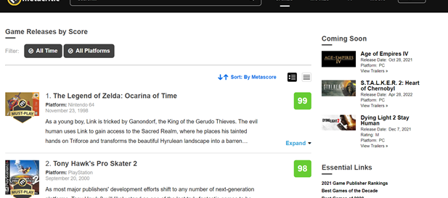
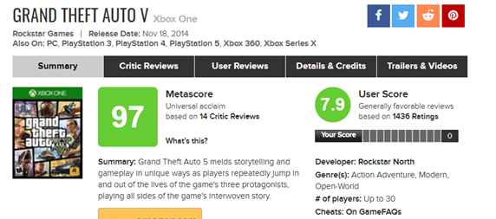
DATA ACQUISITION - CRAWLING -
We used BeautifulSoup library to scrape the relevant information (Name , Release Date , Metascore , User Score) from Metacritic website.
In order to get each game extra information we had to perform GET method on each game. That process took very long time, so we decided to speed up the process and look for API for the additional information for each game (which was challenging by itself)

Slide 11
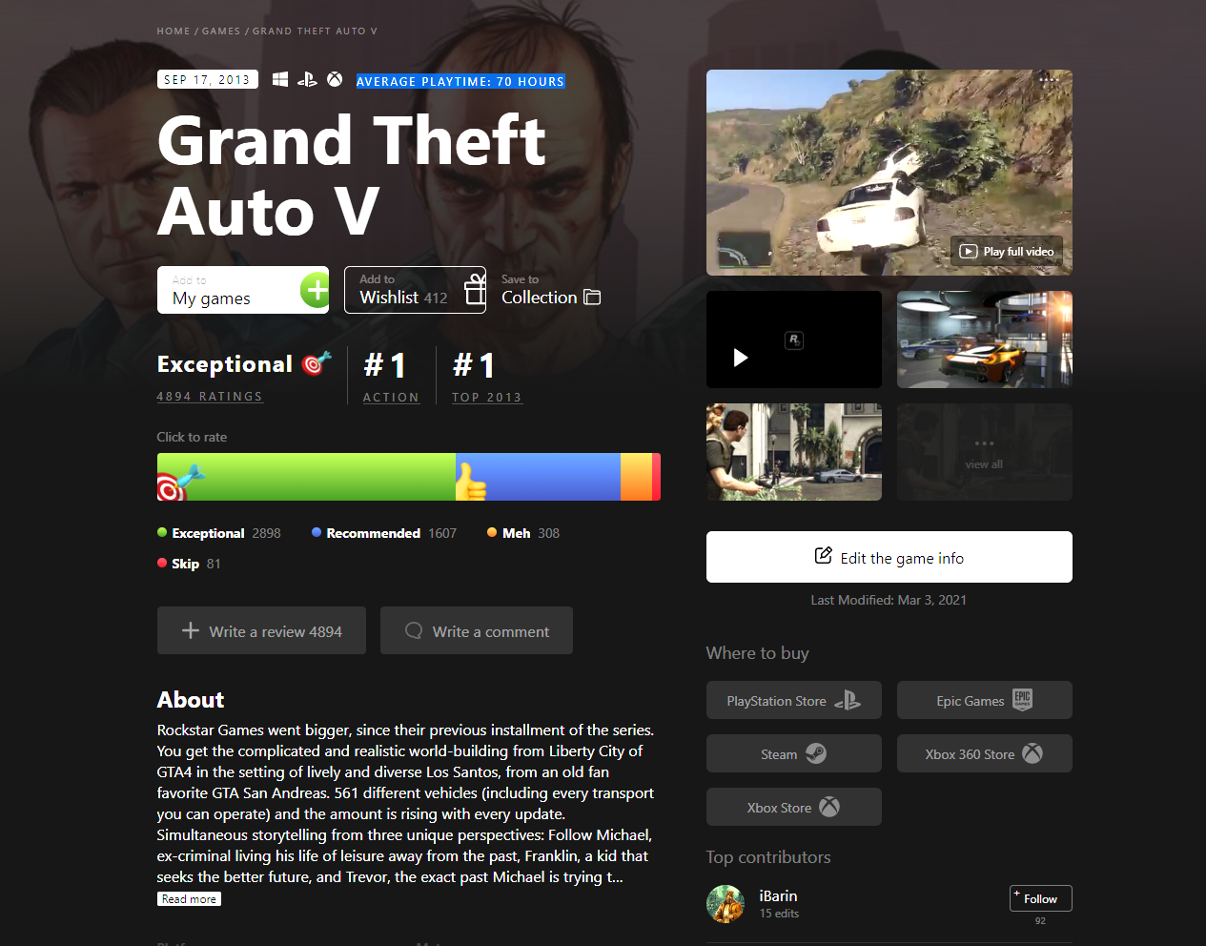
DATA ACQUISITION
- API -
We used a built-in API of RAWG, to get the additional information of each game.
We took the information of over 10,000 games.
Getting the additional information was challenging because both sites defines the same game with different name.
In order to solve this we found that every game had a feature called game slug* and manipulated the API URL accordingly.
Most of the games had the same game slug, we had to give up on the games that had different game slug .
*game slug - templated game name (nickname)
https://www.metacritic.com/game/pc/grand-theft-auto-v
https://rawg.io/games/grand-theft-auto-v

Slide 12
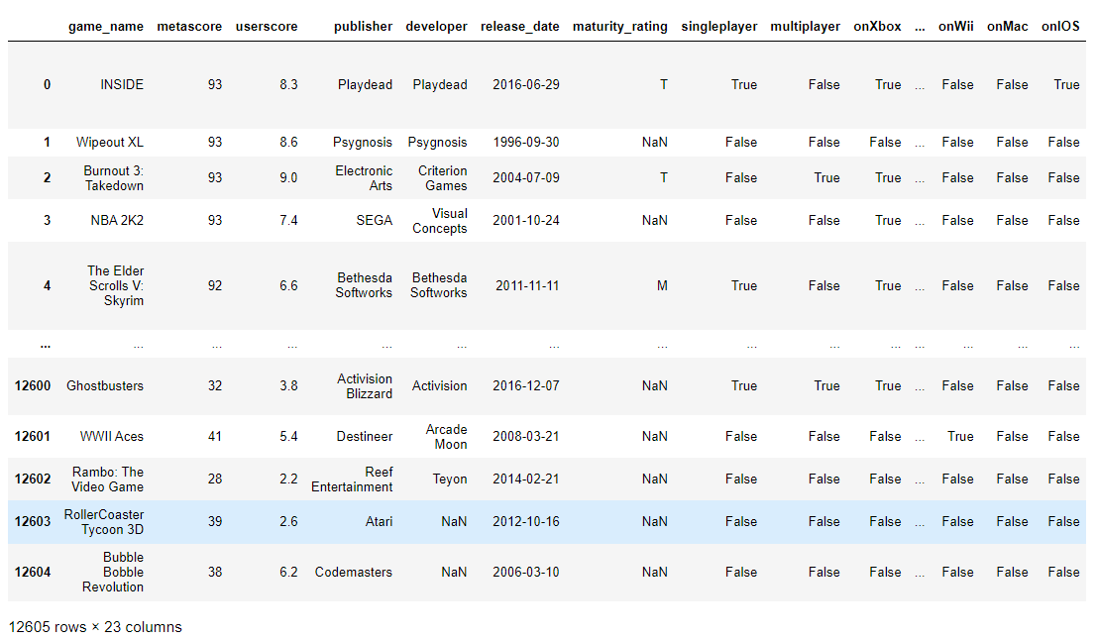
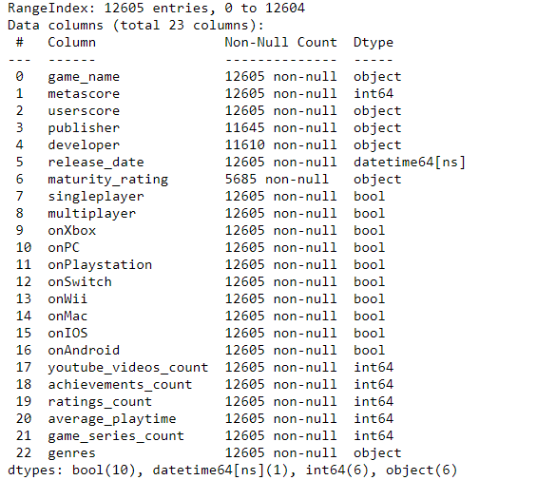
THE DATA FRAME
We can see half of ‘maturity_rating’ column were null values

Slide 13

02
DATA
CLEANING
Cleaning information and filtering data

Slide 14
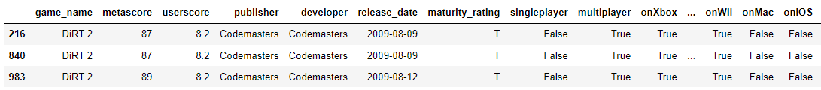
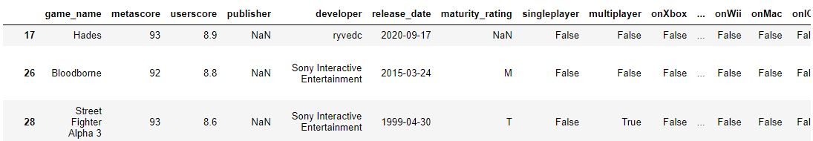
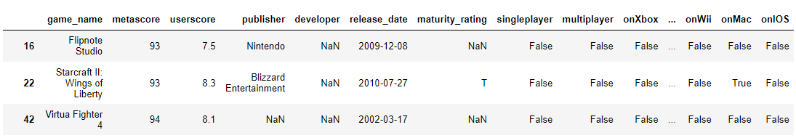
DATA CLEANING
We removed duplicate data by ‘game_name’, we wanted every game to have unique data
We removed null values in ‘developer’ and ‘publisher’ columns

Slide 15
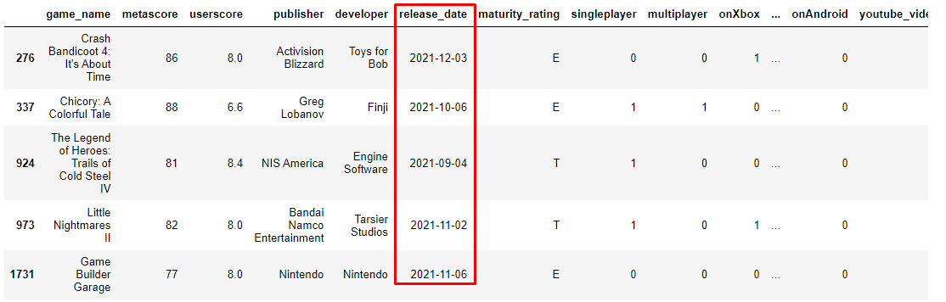
DATA CLEANING
We removed games that haven’t been released yet

Slide 16
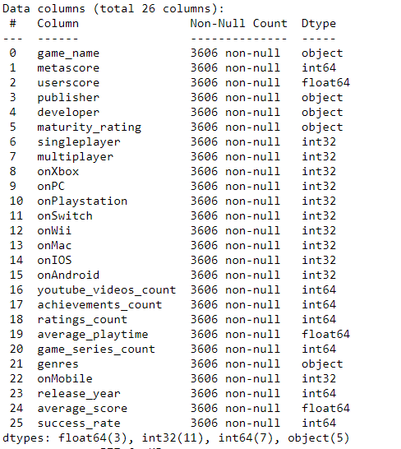
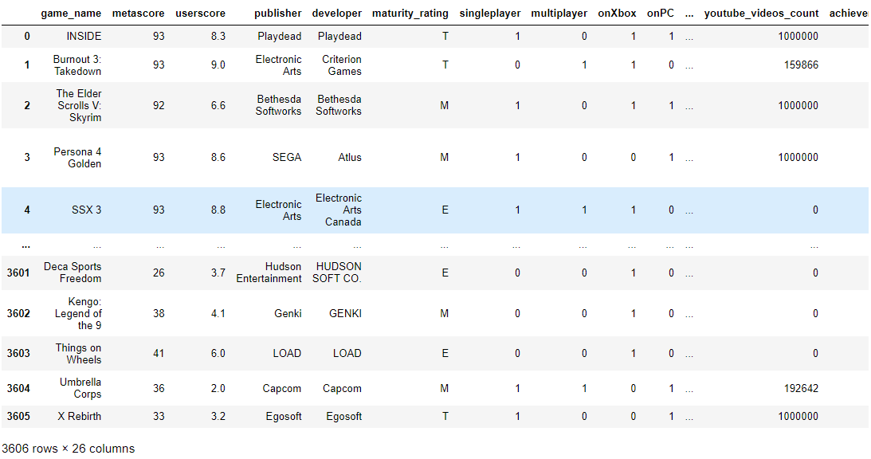
DATA CLEANING
At last this was our dataframe

Slide 17
03
EDA
Visualization of the data

Slide 18
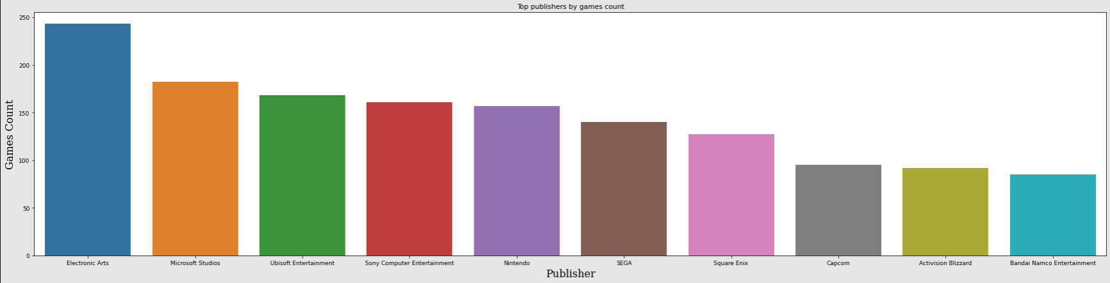
EDA
Top 10 publisher by games amount
Sony, Nintendo, SEGA, Square Enix, Capcom and Bandai Namco are Japanese publishers.
So we can infer that the gaming industry in Japan is very popular
The first top 2 publishers are EA (Electronic Arts) and Microsoft Studious which are two of the biggest companies in the world
Only 1 european representative which is Ubisoft from France

Slide 19
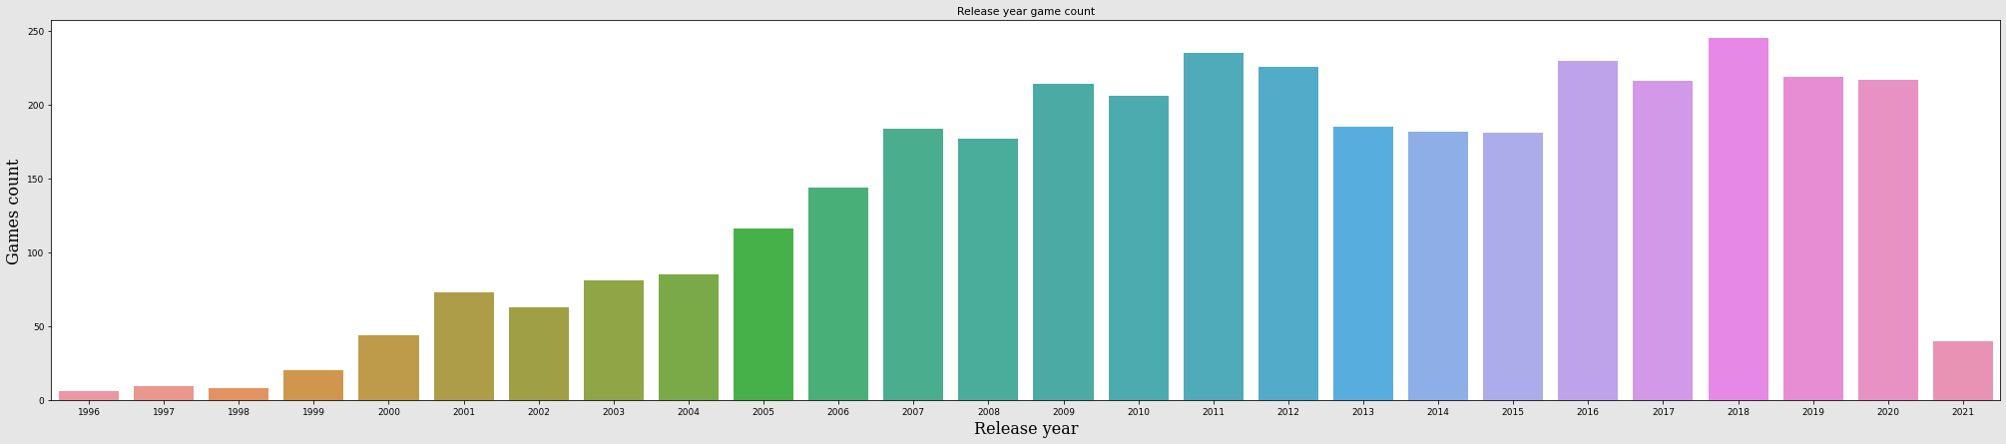
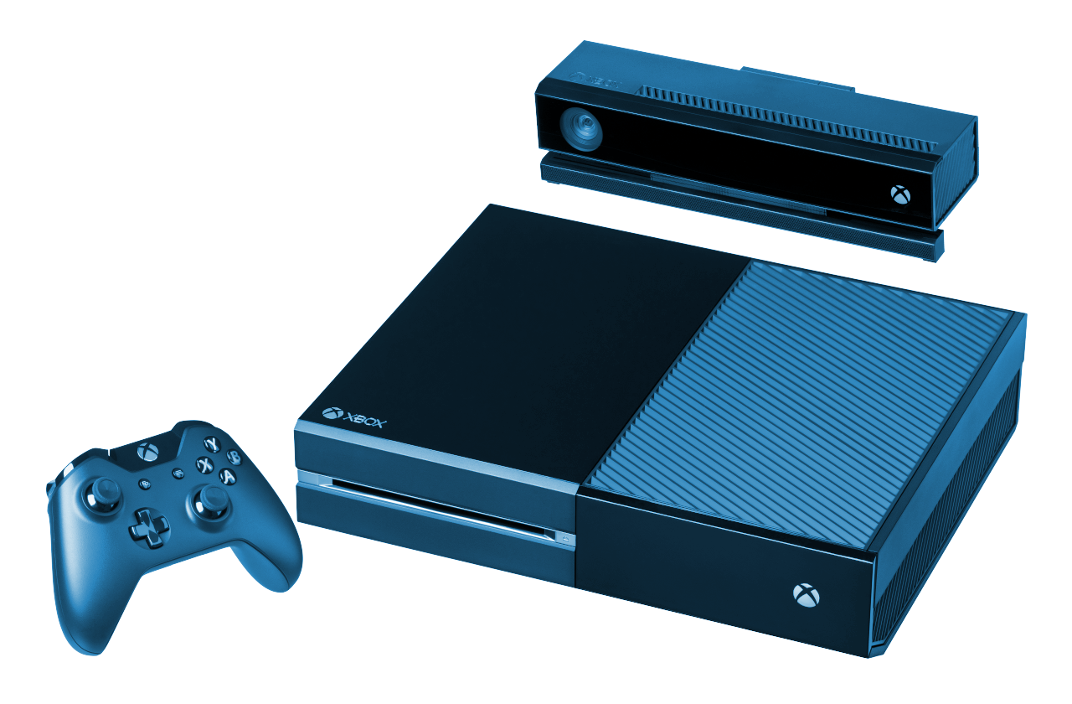
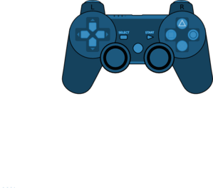
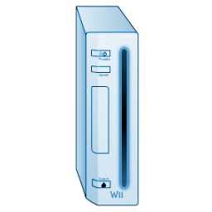
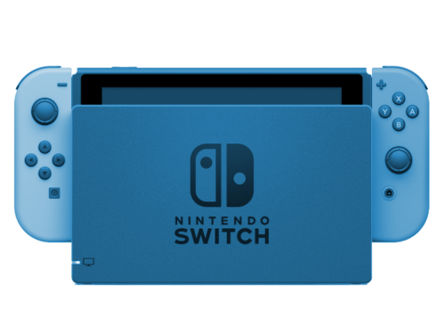
EDA
Top years by games released
PS3 and Wii Consoles released
PS4 and XBOX One Consoles release
nintendo switch release
We can see that 1-3 years after a console release, there’s a big increase in game releases

Slide 20
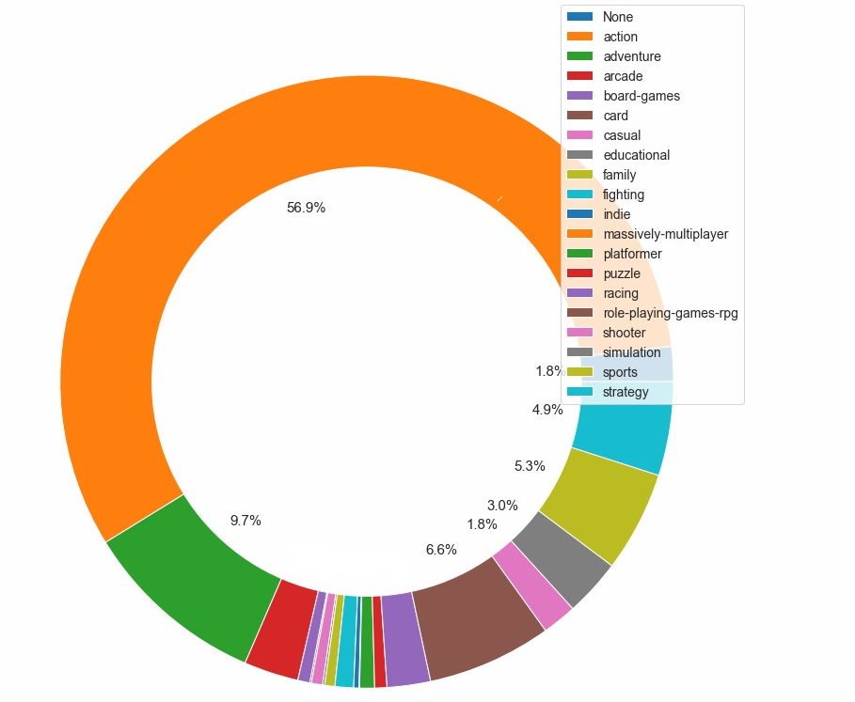
EDA
Distribution by genres
As we can see the most release games are from the genres: action and adventure

Slide 21
SUCCESS RATE
In order to understand whether a game will be successful or not
We have created our own success rating index.
The index consists of three categories: 0 - low success , 1 - medium success , 2 - high success
The parameters of the success index are composed as follows:
0 - If the average score of a game is less than 55 or its average playing time is less than an hour.
1 - If the average score of a game is between 55 and 75 or its average playing time is between 1 and 4.
2 - If the average score of a game is greater than 75 or its average playing time exceeds 4 hours.

Slide 22
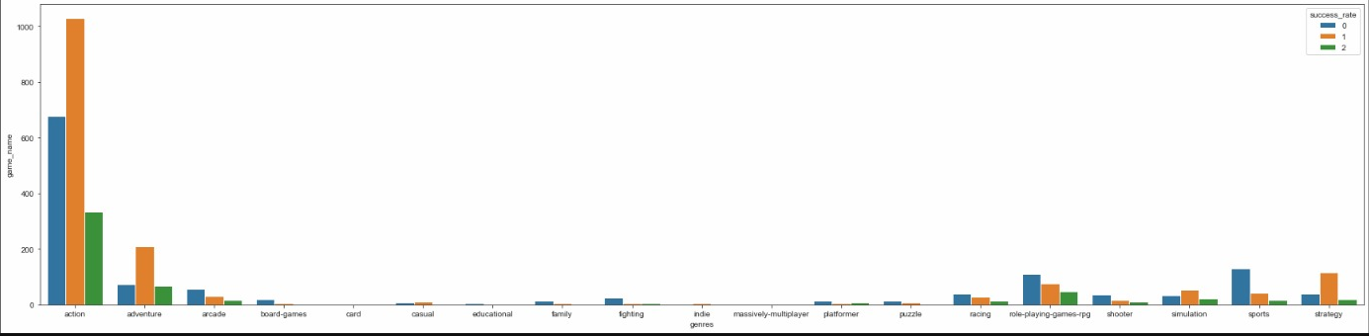
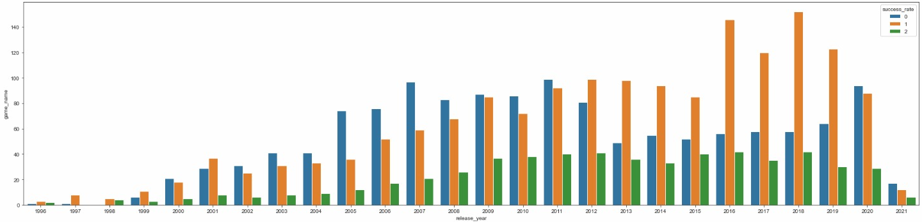
SUCCESS RATE
Genres by success rate
Games by Success rate.

Slide 23
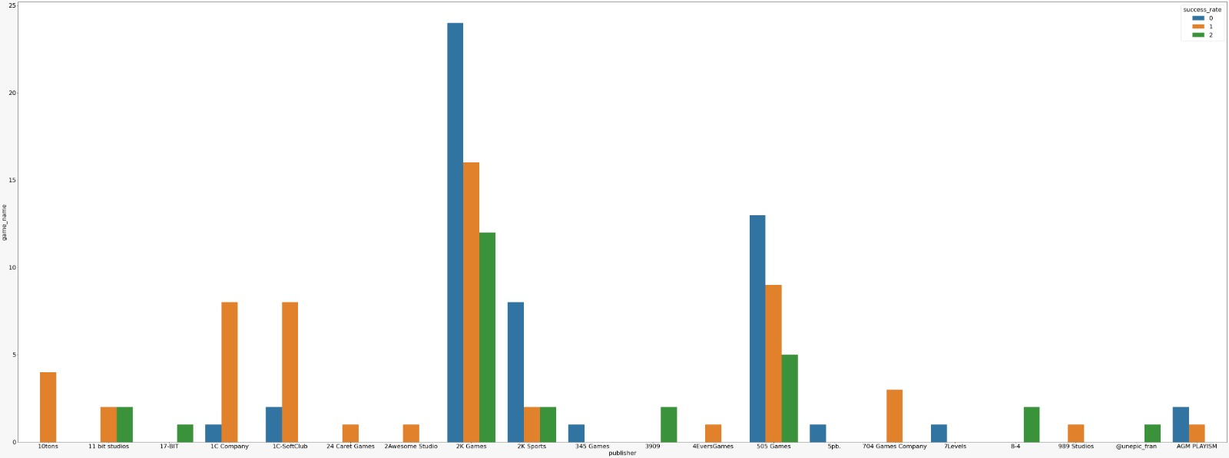
SUCCESS RATE
Publisher by success rate

Slide 24
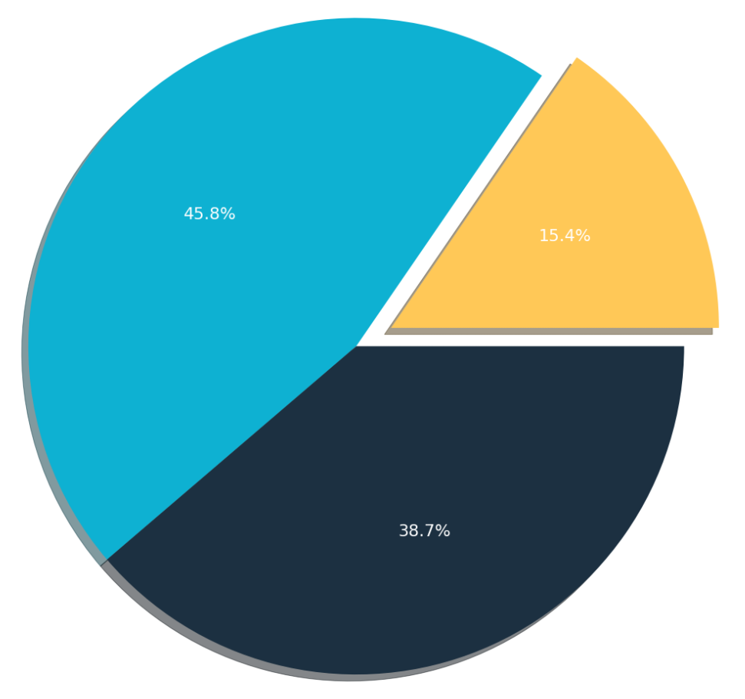
SUCCESS RATE
Success rate distribution
We can see that most of the games has low and medium success rate which means it is not common to create a successful game
Medium
High
Low

Slide 25
04
MACHINE LEARNING
Modeling and predicting

Slide 26
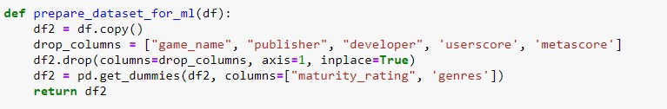
MACHINE LEARNING
REMOVED STRING COLUMNS
We removed ‘game_name’, ‘publisher’, ‘developer’, these columns won’t provide any data for us
AVERAGE SCORE
We merged ‘userscore’ and ‘metascore’ into one column
GET DUMMIES
We converted ‘maturity_rating’ and ‘genres’ columns into dummy columns.

Slide 27
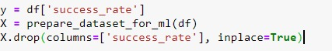
MACHINE LEARNING
We wanted to predict the success rate so we separate the column from the dataset
We used the method train_test_split in order to split the dataset into train data and test data.
We decided to give 20% for testing and a random state of 50 (that what worked best for us)

Slide 28
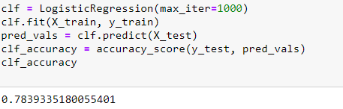
MACHINE LEARNING
LOGISTIC REGRESSION
We created a logistic regression model in order to predict the success_rate of any game
We got 78% success rate which is very good!
Then we tried to find better percentage in other models

Slide 29
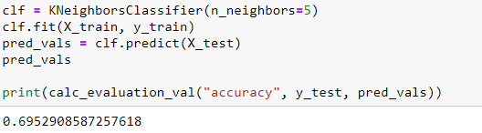
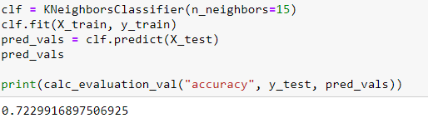
MACHINE LEARNING
KNN
We also tried to predict with KNearestNeighbors (KNN)
Here we got almost 70% of success which was less than the LogisticRegression model
After changing the n_neighbors parameter number of times, we found that we got the highest results for 15 neighbors, and we got 72% of success!

Slide 30


CONCLUSIONS
The most successful genre of games is Action
Most of the best game publishers are from Japan
Most of the games being released about 1-3 years after a console release,
So you might want to try and avoid that to have lesד competitors

Slide 31
GAME OVER
THANKS FOR WATCHING

